Slide 1
MAN 7916 Session 6: SML in Text Analysis
Aaron McKenny
2/12/2025

Slide 2
AGENDA
1 Next week’s homework
2 This week’s readings
3 (Un)supervised Machine Learning
4 In class activity

Slide 3
Commands to run
cd /groups/course.man7916/supervised/ → less man7916launcher → q
./man7916launcher

Slide 4
Summative Homework Assignment
Let’s go through it!

Slide 5
AGENDA
1 Next week’s homework
2 This week’s readings
3 (Un)supervised Machine Learning
4 In class activity

Slide 6
Jiang et al 2020 – Supervised Machine Learning Primer
What is the difference between supervised and unsupervised machine learning?
What is overfitting/regularization?
What is the problem with this and what are some different ways of addressing it?
What are some supervised machine learning models?
What are their strengths and weaknesses?

Slide 7
Jurafsky and Martin 2024 Chapters 4-5
How do logistic regression and naïve Bayes differ in their approach to classification?
Patterns (Bayes) vs boundaries between categories (Logistic Regression)
What factors should influence model selection?
What is meant by feature engineering? What is its role in machine learning?
What are some ways in which bias can enter machine learning algorithms?
What is the role of data size in machine learning?
Will more data always lead to better models?

Slide 8
Kobayashi et al 2018 – Text Classification
Why has organizational research evolved from rule-based to statistical/ML classification?
What are some trade-offs?
What is the role of preprocessing in machine learning?
How do we go about selecting models in machine learning?
Why isn’t ‘accuracy’ enough?
What is a confusion matrix?

Slide 9
Choose Your Own Adventure
What article did you read?
What was the main premise/RQs/Hypotheses?
How did they use content analysis to examine this?
What was your assessment of their analysis?
Clear/rigorous/well-documented? Why (not)?
What was made explicit vs left implicit?

Slide 10
AGENDA
1 Next week’s homework
2 This week’s readings
3 (Un)supervised Machine Learning
Unsupervised (Leftover)
4 In class activity

Slide 11
Think factor analysis… but with words
Factor Analysis
Topic Models
Dimensionality Reduction
Covariance = latent constructs
Items can load on multiple constructs
(barring orthogonal rotation)
Dimensionality Reduction
Covariance = latent topics
Words can be part of multiple topics

Slide 12
Example of topic modeling:
Topics:
Green, Bean, Good
Mother, Gift, Happy
Text 1: “I like green beans, they are good for you. Eating green beans can taste good too. There are several good green bean recipes”
Text 2: “Green beans have multiple good effects on the body. For instance, green beans have been shown to improve good cholesterol.”
Text 3: “Receiving gifts on mother’s day makes most mothers happy. So you should definitely get your mother a gift”
Text 4: “When you give a gift to your mother you not only make your mother happy, but you make the entire family happy.”

Slide 13
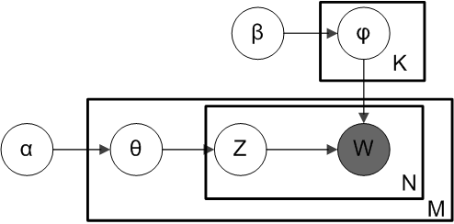
The metaphor is far from perfect
We observe words
Multiple words per document
Topic assignment of words in doc

Slide 14
The metaphor is far from perfect
Dirichlet prior on topic-word distribution
Word distribution of topic
Dirichlet prior on document-topic distribution (sparsity)
Topics
We observe words
Multiple words per document
Each document comprises a distribution of topics
Topic assignment of words in doc
Multiple documents in the corpus

Slide 15
Overcoming Limitations of LDA
Correlated topics – Pachinko Allocation Model | Correlated Topic Model
Hierarchical topics – Hierarchical PAM | Hierarchical LDA
Topics that change over time – Dynamic Topic Model
Topic models with metadata – Supervised Topic Model | Dirichlet Multinomial Regression
Short texts – Pseudo-document-based topic model
Unknown number of topics – Hierarchical Dirichlet Process
Global and local topics – Multi-grain LDA
…and so on…

Slide 16
AGENDA
1 Next week’s homework
2 This week’s readings
3 (Un)supervised Machine Learning
Supervised and ANNs
4 In class activity

Slide 17
Supervised Machine Learning
Have:
Input features
Desired scores/classifications
Want: Computer to accurately predict desired scores/classifications from features
Nigerian | Prince | Money | Viagra | Cialis | Spam? (DV)
Yes | No | No | No | No | No
Yes | Yes | Yes | No | No | Yes
No | Yes | No | Yes | No | No
No | No | Yes | Yes | Yes | Yes

Slide 18
Supervised ML Algorithms
Linear Regression/Logistic Regression
Sound Familiar?
Yup, you already know a Supervised ML algorithm
But you’ve probably not had direct control over hyperparameters
Assumptions, strengths, and weaknesses
Overfitting with multicollinearity
Assumptions of independence
Etc.

Slide 19
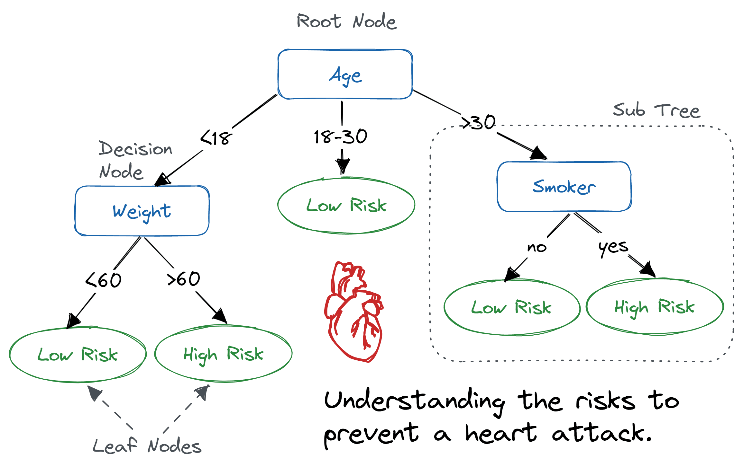
Decision Trees

Slide 20
Beyond Mere Decision Trees
Random Forests
“Ensemble” ML Technique – what does this mean?
Lots of trees in parallel
Why should we look at lots of trees?
Gradient Boosting
Lots of trees… but in series
New trees try to address errors in previous trees

Slide 21
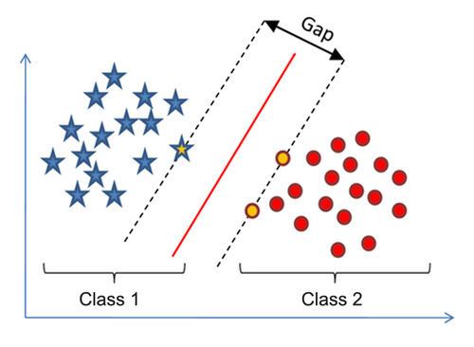
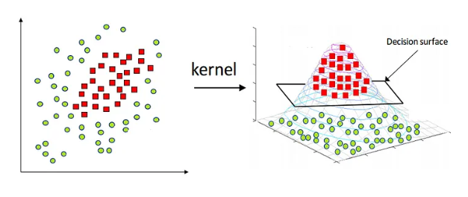
Support Vector Machines
Hyperplanes separate data into classes
Linear… but you can use the “kernel trick” to move into higher dimensional space

Slide 22
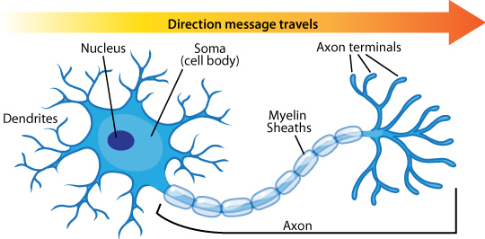
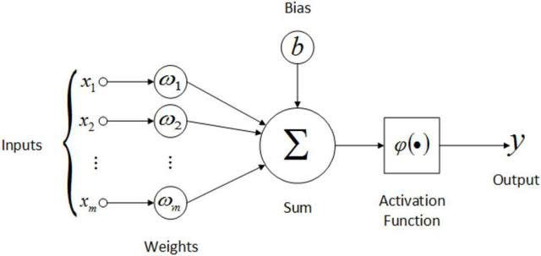
Neural Networks: Neuron
Intercept
IVs
Regression Coefficients
Link Function
DV
This should look remarkably familiar – can you put your finger on it?

Slide 23

Neural Networks (Over)simplified

Slide 24
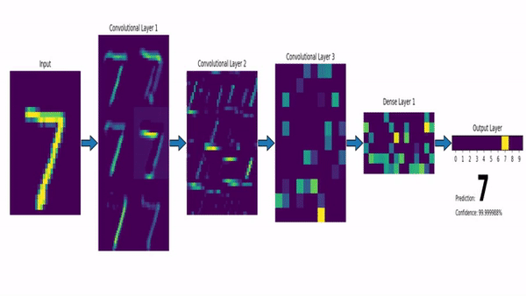
Not all ANNs are the same
Feedforward NN – Data flows from input layer to output layer
Convolutional NN – Like Feedforward, but with “convolution” layers
Convolution – adds filters to highlight features/patterns in the data

Slide 25
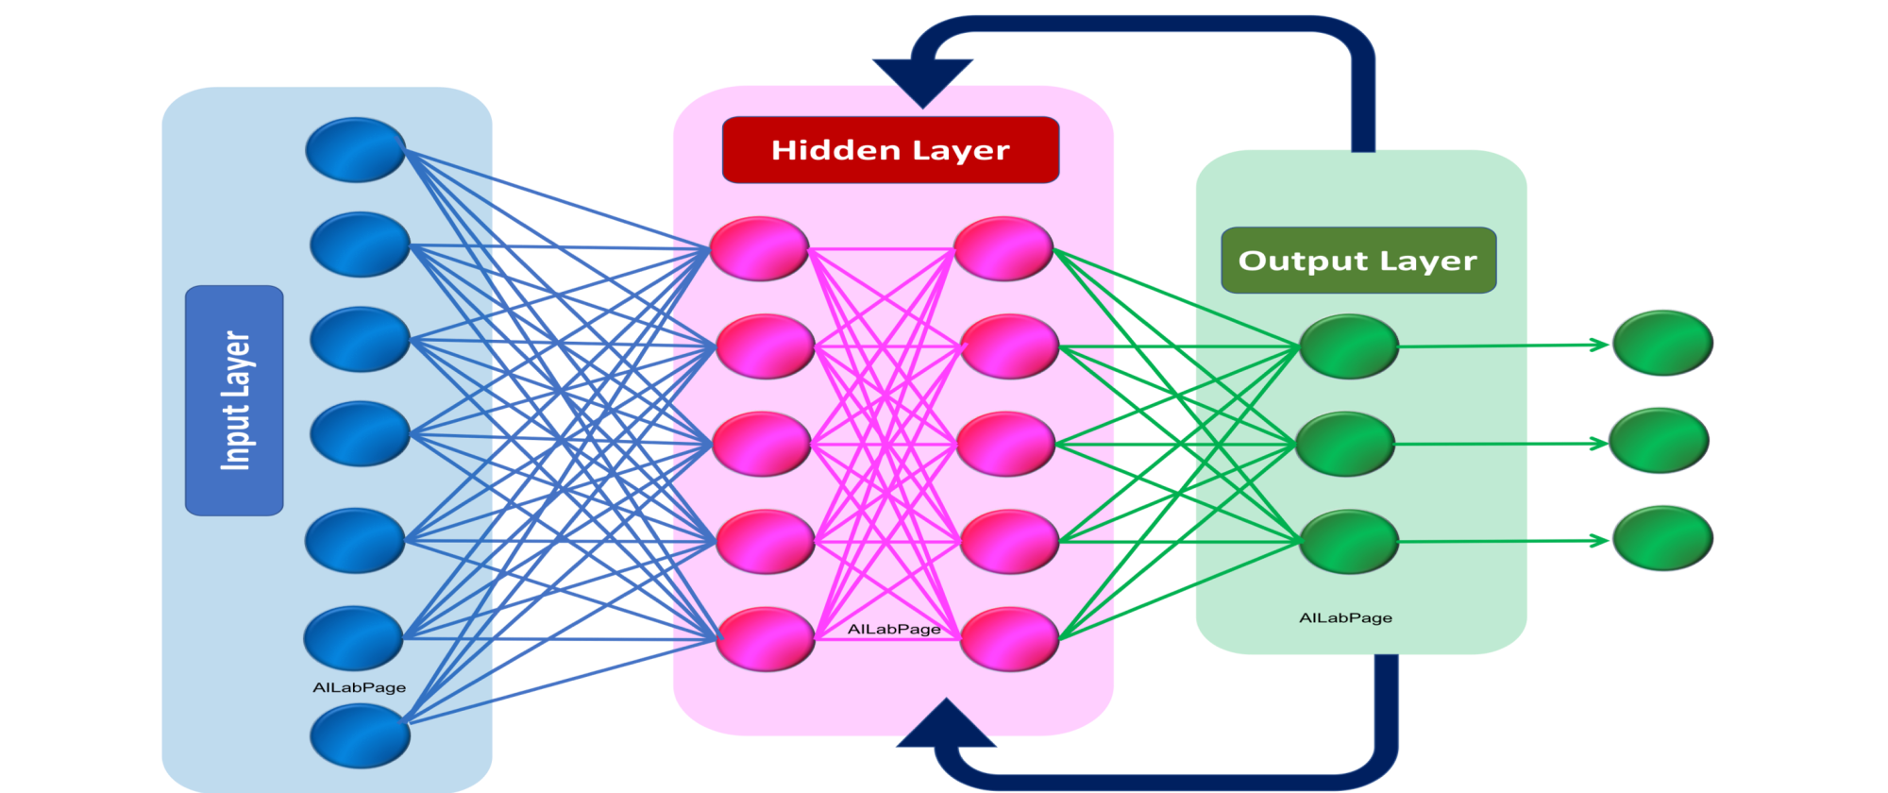
Not all ANNs are the same
Recurrent Neural Network
Outputs are incorporated into the network as data
“Memory”

Slide 26
Training ANNs from scratch
“Deep” neural networks (2+ hidden layers)
But complex ANNs have a bunch!
Many weights and biases to train
Sample size requirements
Models have to learn
Language itself (e.g., English, Spanish, Chinese)
Understand/manipulate/generate that language in some desired way

Slide 27
AGENDA
1 Next week’s homework
2 This week’s readings
3 (Un)supervised Machine Learning
Applications and Execution
4 In class activity

Slide 28

Understand contextualized meaning
Older approaches assume words have a single meaning/use
“Buffalo buffalo Buffalo buffalo buffalo buffalo Buffalo buffalo”
Noun
Verb
N-Place
N-Animal
Part of Speech Tagging
Word Sense Disambiguation

Slide 29
Who is doing what with/to whom?
“During his trip to the United Kingdom, Jeff visited Oxford University. Hana visited Cambridge University in hers.”
Coreference Resolution
People
GPE
Anaphora Resolution
Location
Named Entity Recognition

Slide 30
Hyperparameter Tuning
What are hyperparameters?
What does it mean to “tune” them?
What criteria are we optimizing in doing so
How does this compare to the criteria we normally use in organizational research?
Validity
Reliability
Common Techniques
Grid Search
Random Search/Bayesian Optimization

Slide 31
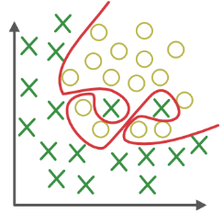
Overfitting
What is it?
Is this a concern in our “normal” research?
How does this crop up in machine learning?
How can we address this?
Train/validation/test sample split / Cross-validation
Regularization
Early Stopping
Dropout Layers
Ensemble Learning

Slide 32

Transparency and Reproducibility
Why is this a big deal?
What kinds of things should we be reporting?
What should we be looking for as:
Researchers?
Reviewers/readers?

Slide 33
AGENDA
1 Next week’s homework
2 This week’s readings
3 (Un)supervised Machine Learning
4 In class activity

Slide 34
Commands to run
cd ~/MAN7916/
module load python/python-3.11.4-oneapi-2023.1.0
source ./.venv/bin/activate
less run_sample_ml.py → q
srun -p normal -t 0-01:00:00 --gres=gpu:1 --pty bash
python3 run_sample_ml.py

